Slide 1


Final Project Spark near real-time sentiment analysis
CN Chen, Mohan K. Patnam, Bruno Janota
CSCI E-63 Big Data Analytics
Harvard University Extension School
Prof. Zoran B. Djordjević

Slide 2
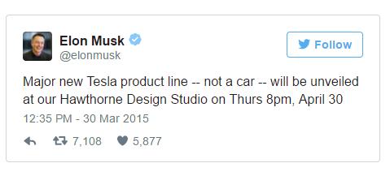
Introduction
Elon Musk made nearly 1B $$ on this single tweet!! http://www.telegraph.co.uk/news/worldnews/northamerica/usa/11505566/Elon-Musks-1bn-tweet-news-of-secret-product-line-sees-Tesla-shares-soar.html

Slide 3
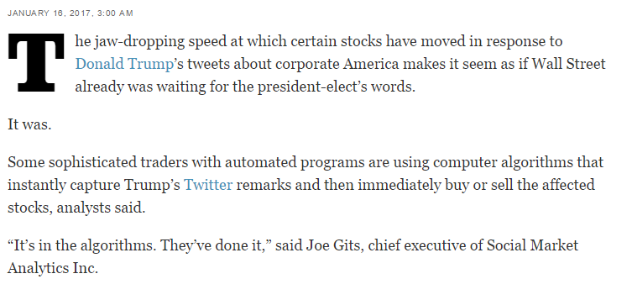
Introduction
When Trump tweets, Wall Street trades - instantly!! http://www.latimes.com/business/la-fi-agenda-trump-tweets-stocks-20170116-story.html

Slide 4
What affects Stock Prices?
Fundamental Factors:
Balance sheet - Assets vs Liabilities
Earnings, Growth etc.
Technical Factors:
Economy, Recession, Inflation
Geo-Political factors etc.
Social Sentiment:
How about Tweets?

Slide 5
Social Sentiment
Does Social Sentiment matter?
Overall user sentiment matters in every industry!
Is Social Media an electronic word of mouth?
Be aware of noise, fake-news, re-tweets and day-to-day gyrations.
Is it a leading indicator of stock prices?
May be or may be not depending on specific person tweeting!
How good is the Noise-to-Signal ratio in tweets?
Machine learning and natural language processing comes to the rescue!

Slide 6
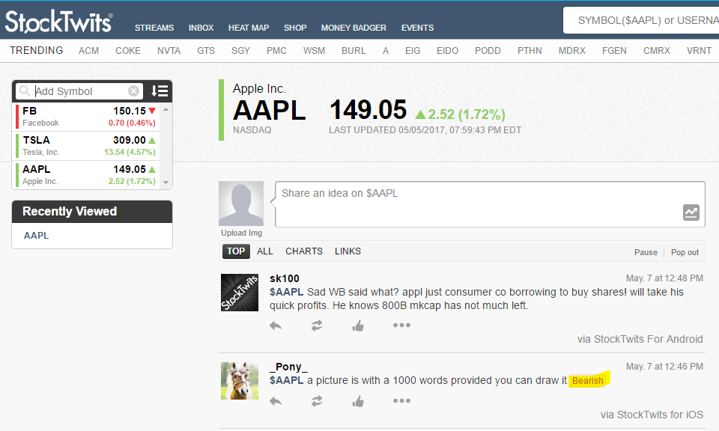
Stock Tweets

Slide 7
Project Statement
Sense the market pulse or social sentiment (bullish vs bearish) using near real-time stream of tweets.
(Data Source: www.StockTwits.com)
A case study of 3 stocks: AAPL, FB, and TSLA.
A methodology to build sentiment scores using Bag-Of-Words approach and Naive-Bayes-Classifier.
Regression analysis to predict stock volatility using sentiment scores.

Slide 8
Project Phases
Automatic Data Download and Wrangling
Output CSV files of raw tweets with optional sentiment.
Sentiment Analysis-1: Bag-of-Words approach
Calculate sentiment score using various standard dictionaries.
Sentiment Analysis-2: Naive-Bayes Classifier
Predict sentiment score and present confusion matrix.
Regression Analysis: Sentiment Score to Predict Stock Price
Present accuracy and loss function.
Spark Streaming of Tweets

Slide 9
Data Download and Wrangling
Data Sources
Tweets from StockTwits - Eg: AAPL tweets in JSON https://api.stocktwits.com/api/2/streams/symbol/AAPL.json
Historical stock prices from Yahoo! Finance - Eg: AAPL historical prices https://finance.yahoo.com/quote/AAPL/history?period1=1488344400&period2=1493524800&interval=1d&filter=history&frequency=1d
Bloomberg intraday prices https://www.bloomberg.com/professional/support/api-library/
Automatic Data Download and Wrangling
StockTwits API: https://stocktwits.com/developers/docs
RESTful API providing JSON responses
Output: CSV files

Slide 10
Tweet Preprocessing (1 of 2)
Several preprocessing steps were executed:
Remove stop words using NLTK corpus
Remove other non-essential words (hyperlinks, @mentions, punctuation)
Tag remaining words for part-of-speech and only keep nouns, verbs, and adjectives using NLTK Perceptron Tagger
Lemmatize remaining words to reduce dimensionality using NLTK WordNetLemmatizer
Drop duplicates

Slide 11
Tweet Preprocessing (2 of 2)
Before:
$TSLA The volume today is insane! Shorts are covering and Bulls are buying!
This is a sign of good things to come! http://markets.businessinsider.com/
news/stocks/teslas-market-cap-passes-gm-201-4-1001895672
After:
tsla volume today insane short cover bull buy sign good thing come news stock teslas market cap pass
Notes:
Remove stop words using NLTK corpus
Remove other non-essential words (hyperlinks, @mentions, punctuation)
Tag remaining words for part-of-speech and only keep nouns, verbs, and adjectives using NLTK Perceptron Tagger
Lemmatize remaining words to reduce dimensionality using NLTK WordNetLemmatizer
Drop duplicates

Slide 12
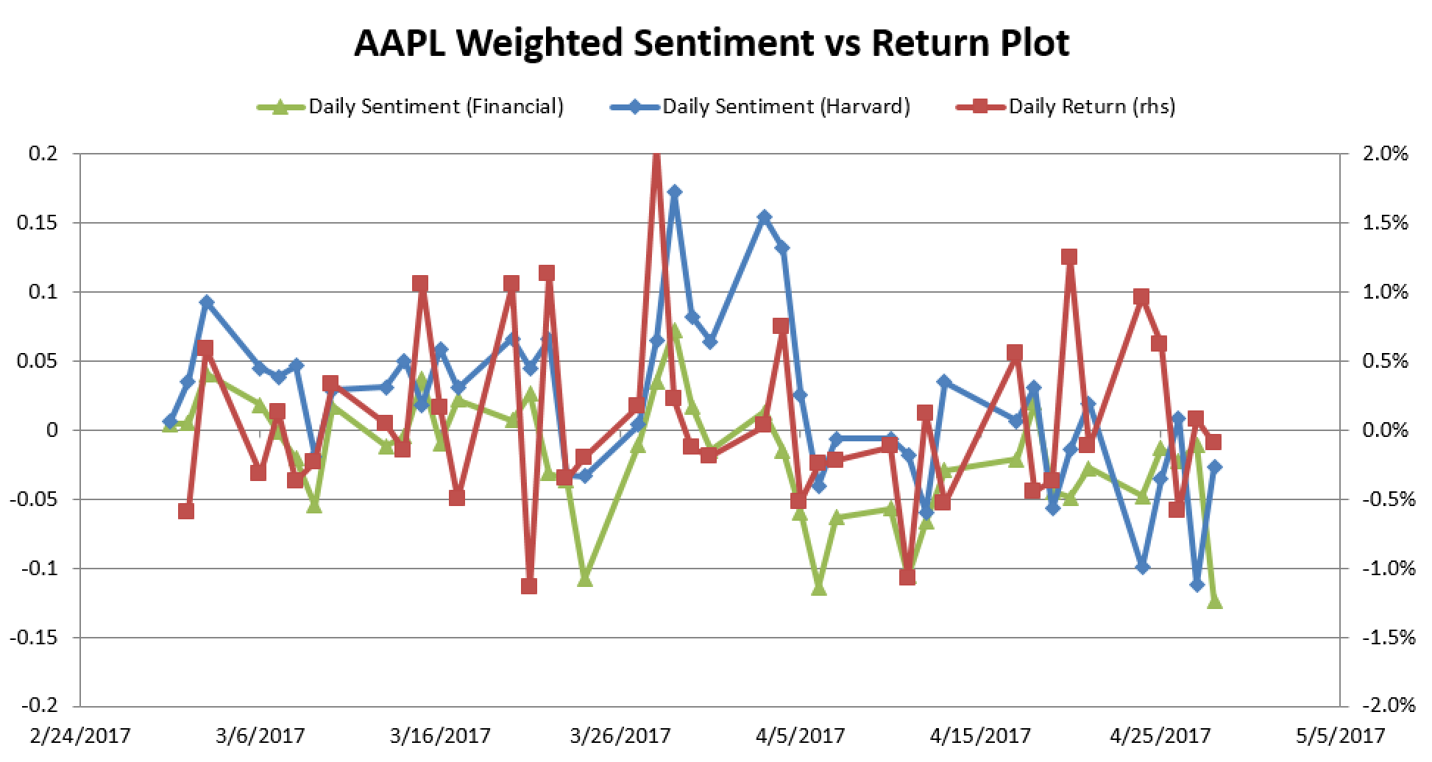
Bag-of-Words Sentiment Analysis
Dictionary Sources
LoughranMcDonald Financial Dictionary (354 pos words / 2,355 neg words)
Harvard IV-4 Dictionary (1,637 pos words / 2,006 neg words)

Slide 13
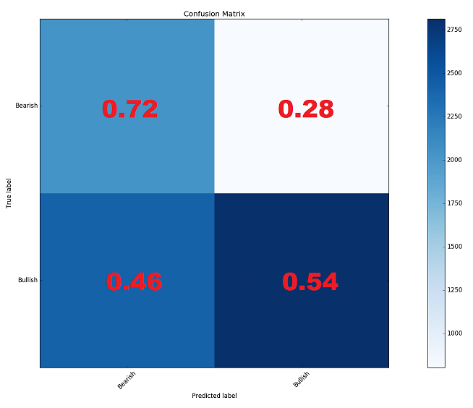
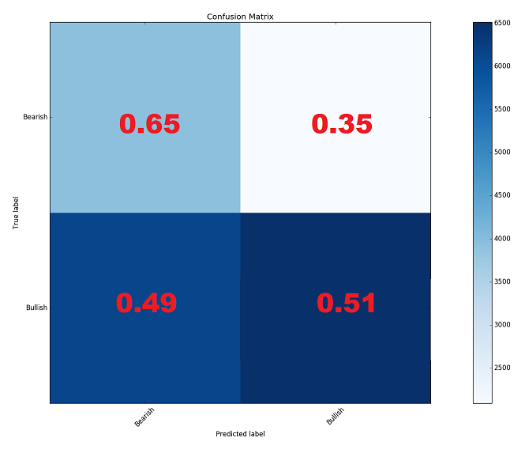
Confusion Matrices
Financial Dictionary
Harvard Dictionary

Slide 14
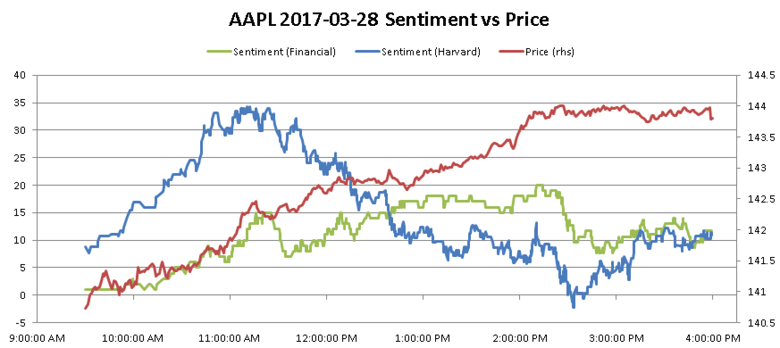
Intraday Bag-of-Words Sentiment vs Price

Slide 15
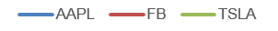
Spark Streaming

Slide 16
Naïve Bayes Classifier
Used Spark 1.6.0 MLlib library multinomial Naive Bayes model
Tokenizing splits a tweet into a list of words
Hashing term frequency counts the number of times a word appears in a tweet
Inverse document frequency calculates uniqueness and gives more weight to words occurring less frequently
Cleaned Text
Words
Feature Vector
Predictions
Tokenizer
HashingTF, IDF
Naïve Bayes Model

Slide 17
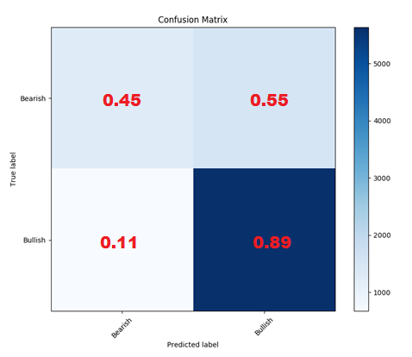
Confusion Matrix
Data used to evaluate the Naive Bayes model:
31,903 labeled tweets for AAPL, FB, and TSLA
03/01/17 – 05/01/17
Test Set Accuracy = 75.6%
 | Train (70%) | Test (30%) | Total¹
Bearish | 6493 | 2783 | 9276
Bullish | 14465 | 6200 | 20665
¹ Not equal to 31,903 because empty tweets after preprocessing are considered duplicated and get removed

Slide 18
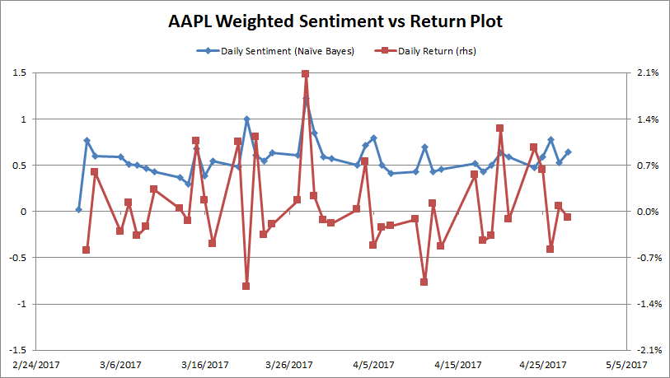
Naive Bayes Sentiment Analysis

Slide 19
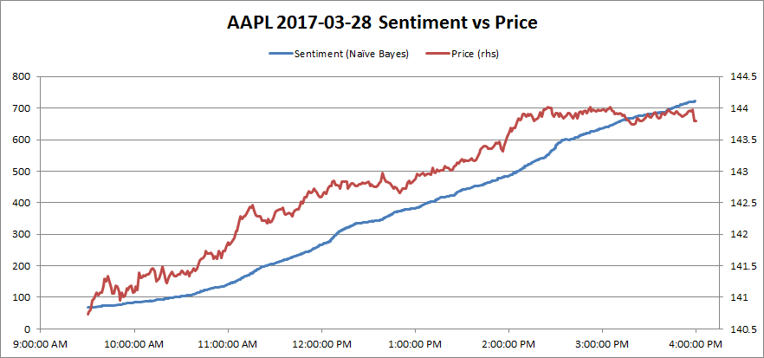
Intraday Naive Bayes Sentiment vs Price

Slide 20
Regression Analysis
Measure correlation between
Volume of Tweets vs Volume Traded
Volume of Tweets vs change in Stock Price
Sentiment Score vs change in Stock Price
Sentiment Score vs Volume Traded
Regression analysis
Sentiment Score vs Close Price
TSLA Correlation
Tweet Volume (#tweets) | Vs Trade Volume | 0.851910836
 | Vs Close Price | 0.42085631
 | Vs Sentiment Score | 0.878318511
Sentiment Score | Vs Close Price | 0.42007267
 | Vs Volume | 0.86695828

Slide 21
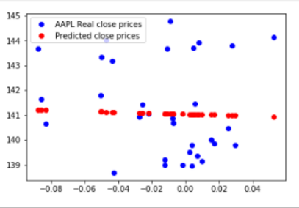
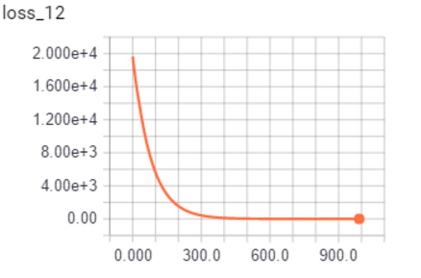
Regression Analysis
Sentiment Score (Financial model) as a predictor of stock price (Stock: AAPL). It is rather a poor fit!

Slide 22
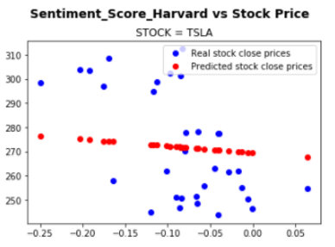
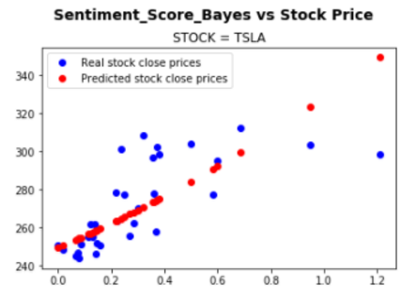
Regression Analysis
Regression Models with Sentiment Scores predicted from other models -

Slide 23
Pros ‘n Cons
Benefits
Provide a simple way to gauge the social sentiment of tweets against changes in stock prices.
Predict aggregate daily sentiment score for a stock from its raw-tweets using multiple models.
Technology is built using Python with its ease of use and seamless integration with web downloads (RESTful API), text analysis (NLTK), streaming (Spark) and machine learning (tensorflow) packages.
The system has the capability to parallel process the analysis using spark concurrency by simultaneously running on multiple stocks.
Challenges & Limitations
StockTwits RESTful API limitation of 200 requests per hour. Each request returns 30 tweets only for a chosen stock. Running batch jobs continuously helped.
Signal-to-noise ratio is often more. Tweets are often very unstructured mentioned in an informal language. Needs more sophisticated natural language techniques to derive the intention of the tweet. Otherwise, this has implication on accuracy of models.

Slide 24
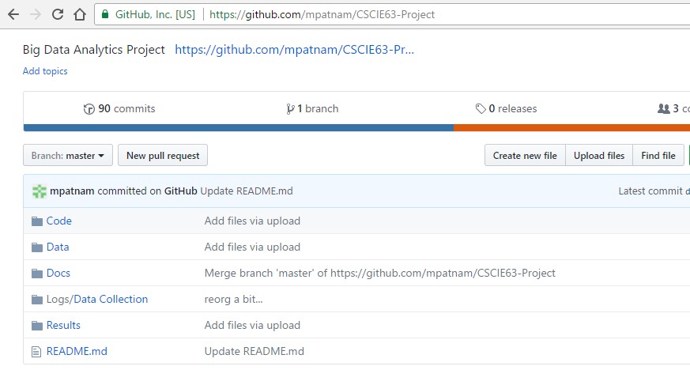
Project Documentation
Data, code, logs and docs available as a github project:
https://github.com/mpatnam/CSCIE63-Project

Slide 25
YouTube URLs & References
Two minute (short):
15 minutes (long):
______________________________________________________________________
Investopedia - Most followed stocks in stocktwits.com
StockTwits API - https://stocktwits.com/developers/docs
Yahoo! Finance for historical stock prices - AAPL Historical Prices
Bloomberg API for intraday prices
LoughranMcDonald Financial Dictionary - http://www3.nd.edu/~mcdonald/World_Lists.html
Harvard IV-4 Dictionary - http://www.wjh.harvard.edu/~inquirer/spreadsheet_guide.htm
Naive Bayes Classifier
Tensorflow API - https://www.tensorflow.org/api_docs/python/

